Slide 1
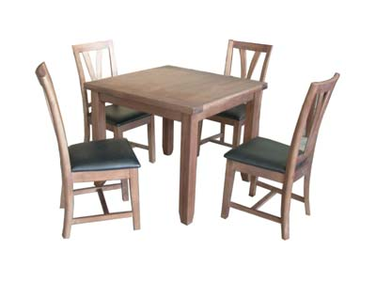
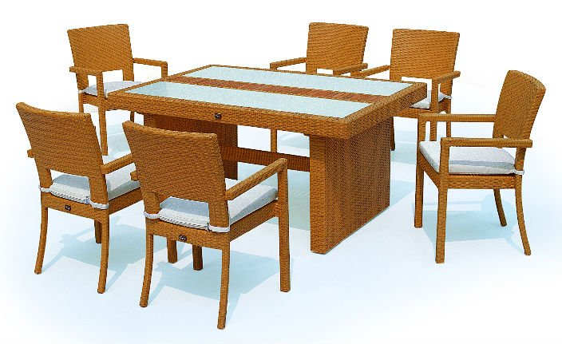
Tables and Chairs

Slide 2
How many chairs would be needed if there were 30 tables?

Slide 3
How many chairs would be needed if there were 60 tables?

Slide 4
How many chairs would be needed if there were 70 tables?

Slide 5
How many chairs would be needed if there were 80 tables?

Slide 6
How many tables would be needed if there were 120 chairs?

Slide 7
How many tables would be needed if there were 130 chairs?

Slide 8
How many tables would be needed if there were 100 chairs?

Slide 9
How many tables would be needed if there were 186 chairs?

